Slide 1


IOT BASED COST EFFECTIVE SMART HOME AUTOMATION
USING CANODE CONCEPT
PRESENTED BY: MANOJ A, POOJA S, MONISHA B, HARINI B
REPRESENTING

Slide 2
INTRODUCTION
PROBLEM STATEMENT:
In modern smart home environments, managing controlling a growing number of devices, sensors, and actuators can become challenging.
Existing solutions often face issues like limited scalability, high costs, unreliable communication and lack of integration between devices.
These challenges make it difficult to achieve seamless automation and real time control in a cost effective manner.
OBJECTIVE:
Real time communication and control over a large number of devices.
A modular architecture allowing for easy expansion and integration.
High resilience to network noise and interference.(Reliable data transmission and control in EMI reduction.)
Compatibility with modern IoT platforms and protocols for user convenience.

Slide 3
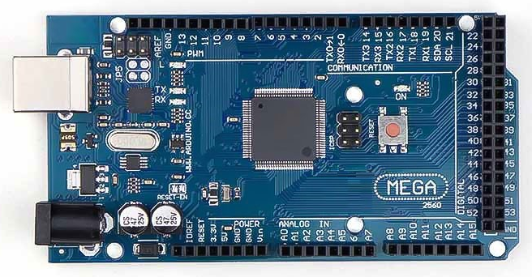
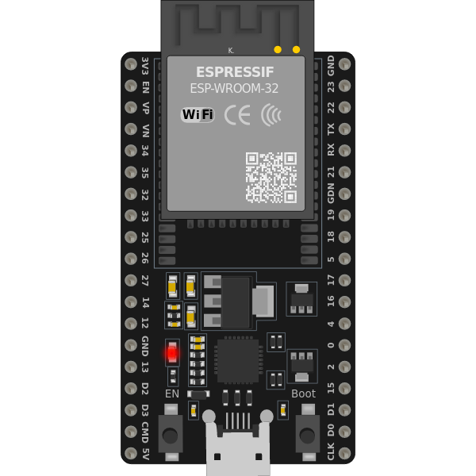
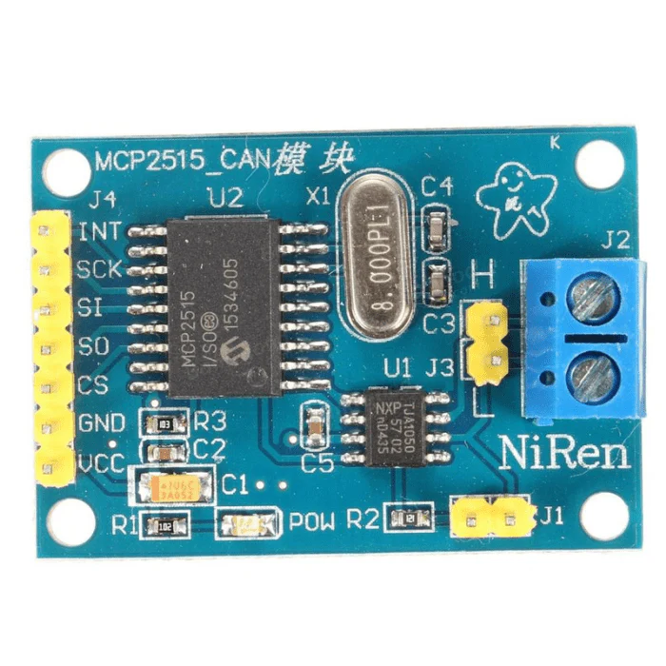
SYSTEM ARCHITECTURE
ESP32
SPI
SPI
SPI
SPI
Termination (120ohm)
Termination (120ohm)

Slide 4
WORKFLOW
Start
Initialize ESP32 (Multi-Master)
Set up CAN Bus Communication
Initialize
AT mega Slaves
No
Detect Nodes?
Yes
Yes
Send/Receive Data to/from Nodes
Errors
Detected?
Perform Node Operations
No
Send/Receive Commands
via Blynk /Website
END

Slide 5
UNIQUENESS AND FUTURE ENHANCEMENT
UNIQUENESS:
Multi Master Capability for simultaneous device control.
Scalable system by adding more devices to the CAN bus
Wireless integration via ESP32 for remote monitoring.
Reliable Communication in noisy environments with CAN bus.
FUTURE ENHANCEMENT:
Real-time monitoring and automation of smart home devices.
Optimized energy consumption through sensor-driven control.
Voice assistant integration for seamless control.
Advanced security with automated alerts and smart locks.

Slide 6


